Slide 1
Cardiovascular examination
Dr T A DIALLO EFSTH / UTG 2016

Slide 2
OSCE based procedure
An objective structured clinical examination (OSCE) is a modern type of examination often used in health sciences (e.g. midwifery, occupational therapy, orthoptics, optometry, medicine, physician assistants/associates, physical therapy, radiography, rehabilitation medicine, nursing,[2] pharmacy, dentistry, chiropractic, paramedicine, podiatry, veterinary medicine).
It is designed to test clinical skill performance and competence in skills such as communication, clinical examination, medical procedures / prescription, exercise prescription, joint mobilisation / manipulation techniques, radiographic positioning, radiographic image evaluation and interpretation of results.
It is a hands-on, real-world approach to learning that keeps you engaged, allows you to understand the key factors that drive the medical decision-making process, and challenges the professional to be innovative and reveals their errors in case-handling and provides an open space for improved decision making based on evidence based practice for real world responsibilities
Wikipedia

Slide 3
Introduction
Wash hands
Introduce yourself
Confirm patient details – name / DOB
Explain the examination
Gain consent
Position the patient at 45° with their chest exposed
Ask if the patient has any pain anywhere before you begin!

Slide 4
General inspection
Bedside – treatments or adjuncts? – GTN glyceryl trinitrate spray / O² / medication / mobility aids
Comfortable at rest? – does the patient look in pain?
Shortness of breath at rest?
Malar flush – plum red discolouration of cheeks – may suggest mitral stenosis
Inspect chest – scars or visible pulsations?
Inspect legs – harvest site scars / peripheral oedema / missing limbs or toes

Slide 5
Hands out with palms facing downwards
Splinter haemorrhages – reddish / brown streaks on the nail bed – bacterial endocarditis
Finger clubbing:
Ask the patient to place the nails of their index fingers back to back
In a healthy individual you should be able to observe a small diamond shaped window (Schamroth’s window)
When finger clubbing is present this window is lost
Finger clubbing has a number of causes including infective endocarditis and cyanotic congenital heart disease

Slide 6
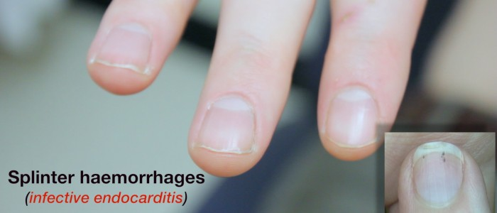
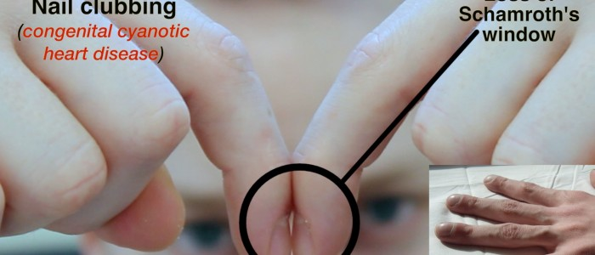
Images

Slide 7
Hands out with palms facing upwards
Colour – dusky bluish discolouration (cyanosis) suggests hypoxia
Temperature – cool peripheries may suggest poor cardiac output / hypovolaemia
Sweaty/Clammy– can be associated with acute coronary syndromes
Janeway lesions – non-tender maculopapular erythematous palm pulp lesions – bacterial endocarditis
Osler’s nodes – tender red nodules on finger pulps / thenar eminence – infective endocarditis
Tar staining – smoker – risk factor for cardiovascular disease
Xanthomata – raised yellow lesions – often noted on tendons of wrist – caused by hyperlipidaemia
Capillary refill – normal is <2 seconds – if prolonged may suggest hypovolaemia

Slide 8

Osler nodes images

Slide 9
Pulses
Radial pulse – assess rate & rhythm
Radio-radial delay:
Palpate both radial pulses simultaneously
They should occur at the same time in a healthy adult
A delay may suggest aortic coarctation
Collapsing pulse – associated with aortic regurgitation
First ensure the patient has no shoulder pain
Palpate the radial pulse with your hand wrapped around the wrist
Raise the arm above the head briskly
Feel for a tapping impulse through the muscle bulk of the arm as blood empties from the arm very quickly in diastole, resulting in the palpable sensation.
This is a Waterhammer pulse and can occur in normal physiological states (fever/pregnancy), or in cardiac lesions (e.g AR / PDA) or high output states (e.g anaemia / AV fistula / thyrotoxicosis)
Brachial pulse – assess volume & character

Slide 10
Blood pressure
Measure blood pressure & note any abnormalities – hypertension / hypotension
Narrow pulse pressure is associated with Aortic Stenosis
Wide pulse pressure is associated with Aortic Regurgitation
Often you won’t be expected to actually carry this out (due to time restraints) but make sure to mention that you’d ideally like to measure blood pressure in both arms.
Carotid pulse:
Assess character & volume – e.g. slow rising character in aortic stenosis
It’s often advised to auscultate the carotid artery for a bruit before palpating as theoretically palpation might dislodge a plaque which could lead to a stroke.

Slide 11
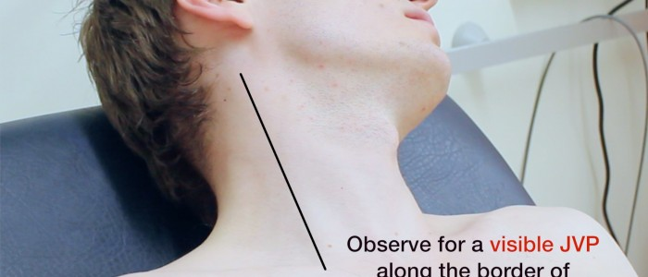
Jugular venous pressure
1. Ensure the patient is positioned at 45°
2. Ask patient to turn their head away from you
3. Observe the neck for the JVP – located inline with the sternocleidomastoid
4. Measure the JVP – number of cm from sternal angle to the upper border of pulsation
Raised JVP may indicate – Fluid overload / Right ventricular failure / Tricuspid regurgitation

Slide 12
Hepatojugular reflux
Apply pressure to the liver
Observe the JVP for a rise
In healthy individuals this should last no longer than 1-2 cardiac cycles (it should then fall)
If the rise in JVP is sustained & equal to or greater than 4cm this is a positive result
A positive hepatojugular reflux sign is suggestive of right sided heart failure / tricuspid regurgitation

Slide 13
Face
Eyes
Conjunctival pallor – anaemia – ask patient to gently pull down lower eyelid
Corneal arcus – yellowish/grey ring surrounding the iris – hypercholesterolaemia
Xanthelasma – yellow raised lesions around the eyes – hypercholesterolaemia
Mouth
Central cyanosis – bluish discolouration of lips / underneath tongue
Angular stomatitis – inflammation of corners of the mouth – iron deficiency
High arched palate – suggestive of Marfans – ↑ risk of aortic aneurysm/dissection
Dental hygiene – important if considering sources for infective endocarditis

Slide 14
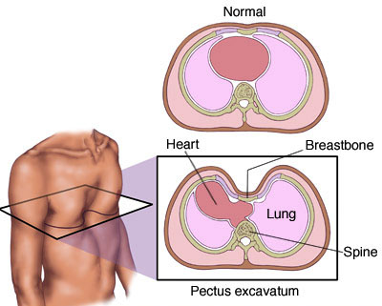
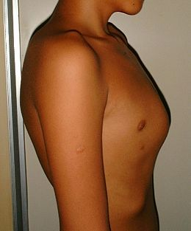
Close inspection of the chest
Scars:
Thoracotomy – minimally invasive valve surgery
Sternotomy – CABG / valve surgery
Clavicular – Pacemaker
Chest wall deformities – pectus excavatum / pectus carinatum
Visible pulsations – forceful apex beat may be visible – hypertension/ventricular hypertrophy

Slide 15
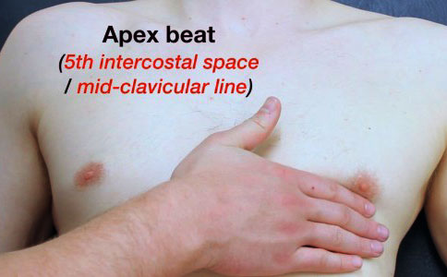
Palpation
Heaves- left sternal edge – LVH & RVH
Thrills – palpable murmurs felt over aortic valve & apex beat
Apex beat:
5th intercostal space / Midclavicular line
Lateral displacement suggests cardiomegaly
Once located, count out the intercostal spaces to make it clear you have located it

Slide 16
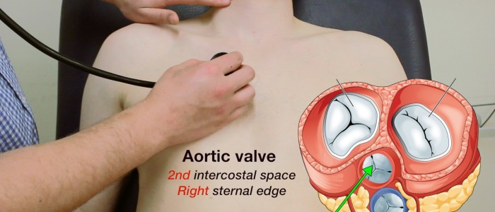
Auscultation
Auscultate the 4 valves
Palpate the carotid pulse to determine the 1st heart sound
Auscultate using the diaphragm of the stethoscope
Aortic valve – 2nd intercostal space – right sternal edge
Pulmonary valve – 2nd intercostal space – left sternal edge
Tricuspid valve – 5th intercostal space – lower left sternal edge
Mitral valve – 5th intercostal space – midclavicular line (apex beat)
Repeat auscultation across the 4 valves with the bell of the stethoscope

Slide 17
Radiation of the murmur
Carotid arteries (with breath held) – radiation of aortic stenosis murmur
Axilla – radiation of heart murmur into the left axilla – mitral regurgitation
Left sternal edge – Aortic regurgitation

Slide 18
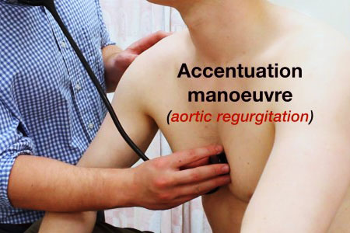
Accentuation maneuvers
These maneuvers cause particular murmurs to become louder DURING expiration
Roll onto left side & listen to mitral area with bell during expiration – mitral murmurs (stenosis & regurgitation)
Lean forward & listen over aortic area during expiration – aortic murmurs are louder (stenosis & regurgitation)

Slide 19
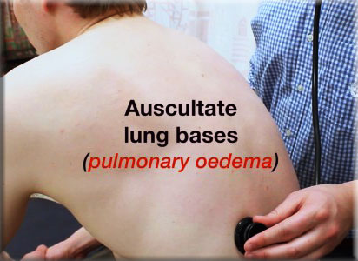
To complete the examination
Auscultate lung bases – crackles may suggest pulmonary oedema – left ventricular failure
Sacral oedema / Pedal oedema – may indicate right ventricular failure
Thank patient
Wash hands
Summarise findings

